Slide 1
g
Heart Valve Society
Valve Research Network (VRN) meeting
19th of April 2025
Cairo, Egypt

Slide 2
Agenda
Donna de Geest
7:15 AM – 8:00 AM Aortic Valve Session
Regulatory Update
Database Progress
Scientific Update
Finances
8:00 AM – 8:15 AM Aortic Kids Session
8:15 AM – 9:00 AM Mitral Tricuspid Valve Session
Database Progress
Scientific Update
Finances

Slide 3
Introduction
Peter Verbrugghe

Slide 4
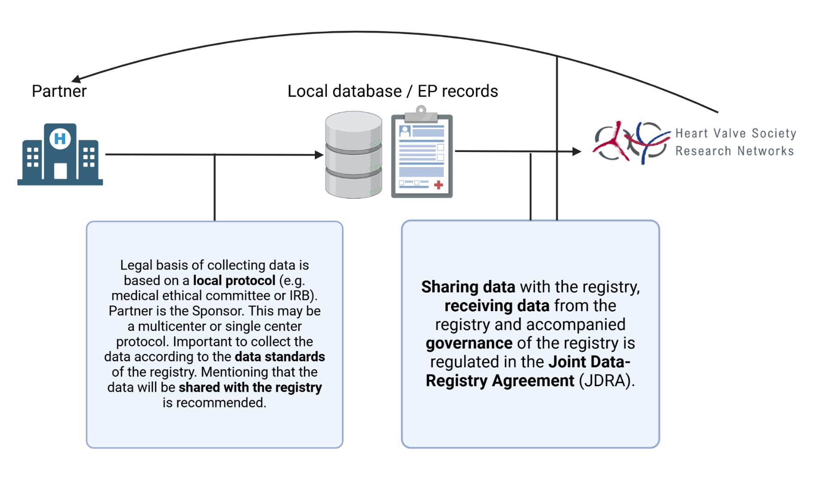
Regulatory update
Local IRB/ethical protocol vs. JDRA
Donna de Geest

Slide 5
Regulatory update
Center information
Donna de Geest
The JDRA has been communicated to 49 active and silent centers (HVS AV Database)
Signed JDRA 11 centers (57% of patient total)
Confirmed participation 14 centers (28% of patient total)
Total 25 centers (85% of patient total)
No confirmation 24 centers (15% of patient total)

Slide 6
Regulatory update
Decision tree JDRA
Kevin Veen

Slide 7
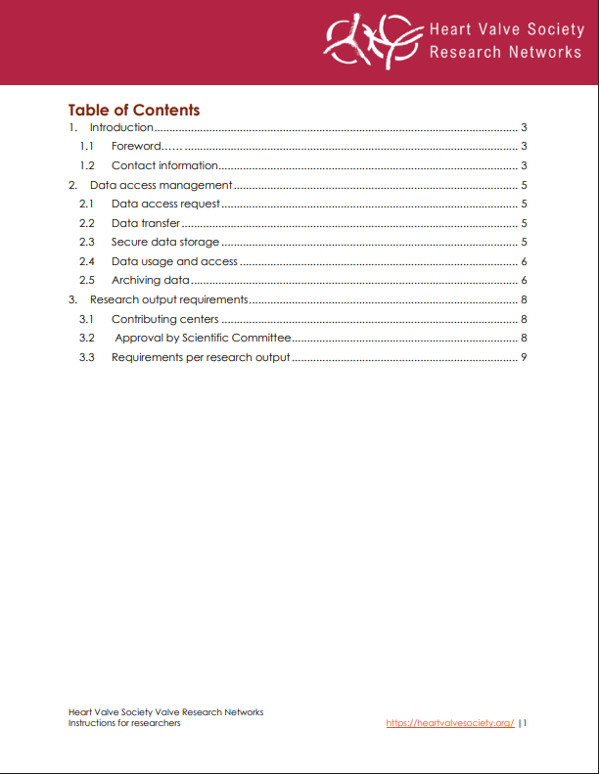
Regulatory update
Instructions for researchers
Donna de Geest

Slide 8
Transition Castor
Data quality procedure
Carlijn van der Ven
Data cleaning
Exclusion of patients (n = 555)
Inactive centers (n = 434)
11651 – 10662 = 989 patients excluded.
n = 11651
n = 10662
Patient Identifiable Data in Telemedicine

Slide 9
Database Progress
Patient inclusion per year
Carlijn van der Ven

Slide 10
Database Progress
Main reason for inclusion in 2024: Q2-Q4
Carlijn van der Ven

Slide 11
Database Progress
Aortic Valve Repair vs. Replacement
Carlijn van der Ven
80.5%
19.5%

Slide 12
Database Progress
Median follow-up over time
Carlijn van der Ven
1st of October 2024
2.58 years (IQR: 0.21 – 6.48
1st of April 2025
2.94 years (IQR: 0.30 - 6.79)
)

Slide 13
Database Progress
Follow-up Completeness
Carlijn van der Ven
75.71%
70.15%
49.08%

Slide 14
Scientific Update
Bardia Arabkhani

Slide 15
Scientific Update
Newly published projects
Bardia Arabkhani
van der Ven C, Kluin J, Takkenberg J, et al. On behalf of the Aortic Valve Research Network Investigators Data Resource Profile: Heart valve Society Aortic Valve Database (HVS AV Database) Journal of the Heart Valve Society. 2024;1(1). doi:10.1177/30494826241296370
Tastet L, Salaun E, de Heer F, et al. Mid-term Clinical and Hemodynamic Outcomes in Patients Treated for Aortic Regurgitation and/or Ascending Aorta Aneurysm: The 3-Year Flight of the AVIATOR Registry Journal of the Heart Valve Society. 2024;1(1). doi:10.1177/30494826241300881
Zito F, Veen K, Melina G, et al. Aortic Valve repair in adults: long-term clinical outcomes and echocardiographic evolution in different valve repair techniques Eur J Cardiothorac Surg. 2025;67(3):ezaf020.

Slide 16
Scientific Update
Ongoing research projects
Bardia Arabkhani
Emmanuel Lansac Pouya Youssefi | Title: | Aortic valve repair using external aortic ring annuloplasty: a multicentric analysis of outcomes
 | Data extraction: | November 2018, October 2019, February 2023, March 2023, September 2023
 | Current status: | Writing manuscript
Frederiek de Heer Jolanda Kluin | Title: | Determinants of conversion to aortic valve replacement in patients selected for valve repair / Using artificial intelligence to predict the best surgical strategy in patients with aortic valve regurgitation of aortic aneurysm. Insights from the Heart Valve Society Aortic Valve Database
 | Data extraction: | January 2020, July 2020
 | Current status: | Was rejected, will be resubmitted.

Slide 17
Scientific Update
Ongoing research projects
Bardia Arabkhani
Maciej Matuszewski | Title: | Early and mid-term clinical and echocardiography outcomes in patients undergoing aortic valve repair / replacement for isolated aortic regurgitation from AVIATOR database
 | Data extraction: | Not yet
 | Current status: | -
Matteo Pettinari Peter Verbrugghe Laurent de Kerchove | Title: | Impact of preoperative aortic regurgitation and leaflet repair on immediate and long term outcomes of valve sparing root replacement in patient with TAV.
 | Data extraction: | April 2020, April 2023, February 2024
 | Current status: | Final version ready to send to co-authors and Scientific Committee for final approval.

Slide 18
Scientific Update
Ongoing research projects
Bardia Arabkhani
Matteo Pettinari | Title: | Aortic valve reparability in aorta dissection patients: insight from the AVIATOR registry
 | Data extraction: | February 2024
 | Current status: | Writing manuscript
Pepijn Grashuis Hanneke Takkenberg Jerry Braun Shanti Khargi | Title: | Type of cusp fusion and commissural orientation as a predicting factor of aortic valve repair failure in patients with bicuspid aortic valves
 | Data extraction: | December 2020
 | Current status: | Extra data analysis (with existing data) and rewriting discussion.

Slide 19
Scientific Update
Ongoing research projects
Bardia Arabkhani
Mariya Saddiqa Marianna Buonocore Peter Verbrugghe | Title: | Aortic valve repair and replacement in patients affected by infective endocarditis: short and mid-term results from the AVIATOR Registry.
 | Data extraction: | July 2021, February 2024, June 2024
 | Current status: | Finalizing manuscript, abstract will be submitted to HVS 2025.
Carlotta Brega | Title: | Aortic Valve Sparing Root Replacement And Myocardial Dysfunction
 | Data extraction: | December 2022
 | Current status: | Under current review by Journal of Cardiovascular Medicine.

Slide 20
Scientific Update
Ongoing research projects
Bardia Arabkhani
Adine de Keijzer Danial Pichoy Emmanuel Lansac | Title: | Propensity-Matched Comparison of Aortic Valvuloplasty and Prosthetic Aortic Valve Replacement in Adults (CAVIAAR extension)
 | Data extraction: | April 2023, May 2023, June 2023, September 2023, March 2024
 | Current status: | Drafting of manuscript. Abstract will be presented at HVS 2025.
Claudia Romagnoni Andrea Mangini | Title: | Optimizing Bicuspid Aortic Valve Repair: evaluating the role of commissural orientation.
 | Data extraction: | Not yet
 | Current status: | Rejected by Scientific Committee.

Slide 21
Scientific Update
Ongoing research projects
Bardia Arabkhani
Francesco Zito Bardia Arabkhani | Title: | Isolated Aortic Valve Regurgitation: comparing clinical outcomes across different surgical approaches
 | Data extraction: | August 2024
 | Current status: | Manuscript has been sent to co-authors, will be presented as an oral presentation at the HVS Annual Meeting 2025.
Pascal Govers Bardia Arabkhani | Title: | Valve-Sparing Aortic Root Replacement: optimal annual case volume for surgery using real-world data
 | Data extraction: | October 2024
 | Current status: | Finalizing data analysis.

Slide 22
Scientific Update
Ongoing research projects
Bardia Arabkhani
Reda Rhellab Kevin Veen | Title: | Determining excess mortality in patients undergoing biological and mechanical aortic valve replacement and aortic valve repair
 | Data extraction: | October 2024
 | Current status: | Finalizing manuscript to be sent to co-authors. Will be presented as an invited abstract during the HVS Annual meeting 2025.
Peter Verbrugghe Zohra Charaf | Title | Study Isolated Cusp Prolaps
 | Data extraction: | March 2025
 | Current status: | Data analysis.

Slide 23
Scientific Update
Ongoing research projects
Bardia Arabkhani
Bardia Arabkhani Carlijn van der Ven | Title: | Male-Female Outcome Differences in Patients Undergoing Valve-Sparing Root Replacement and Isolated Valve Repair
 | Data extraction: | Planned for April 2025
 | Current status: | Accepted by Scientific Committee
Emmanuel Lansac Claudia Côté Pichoy Danial | Title | Outcomes of Valve-Sparing Root Replacement and Aortic Valve Repair in Patients Ages 65 and Older
 | Data extraction: | February 2025
 | Current status: | Data analysis.

Slide 24
Scientific Update
Ongoing research projects
Bardia Arabkhani
Emmanuel Lansac Nathanael Shraer | Title: | Reimplantation versus Remodeling with Annuloplasty Valve Sparing Root Replacement: is there a difference?
 | Data extraction: | February 2025
 | Current status: | Data analysis.

Slide 25
Next goals
Carlijn van der Ven
Follow-up data
Inclusion of patients undergoing Ross procedure (n = 293)
Enhance data quality
Scientific Output

Slide 26
Financial update
Peter Verburgghe

Slide 27
Heart Valve Society
Valve Research Network (VRN) meeting
19th of April 2025
Cairo, Egypt

Slide 28
Project
Reda Rhellab
All patients aged 0-18 years with AVD (AR and/or AS), and/or aortic aneurysm, undergoing surgical or transcatheter treatment for either
Retrospective inclusion
Prospective inclusion

Slide 29
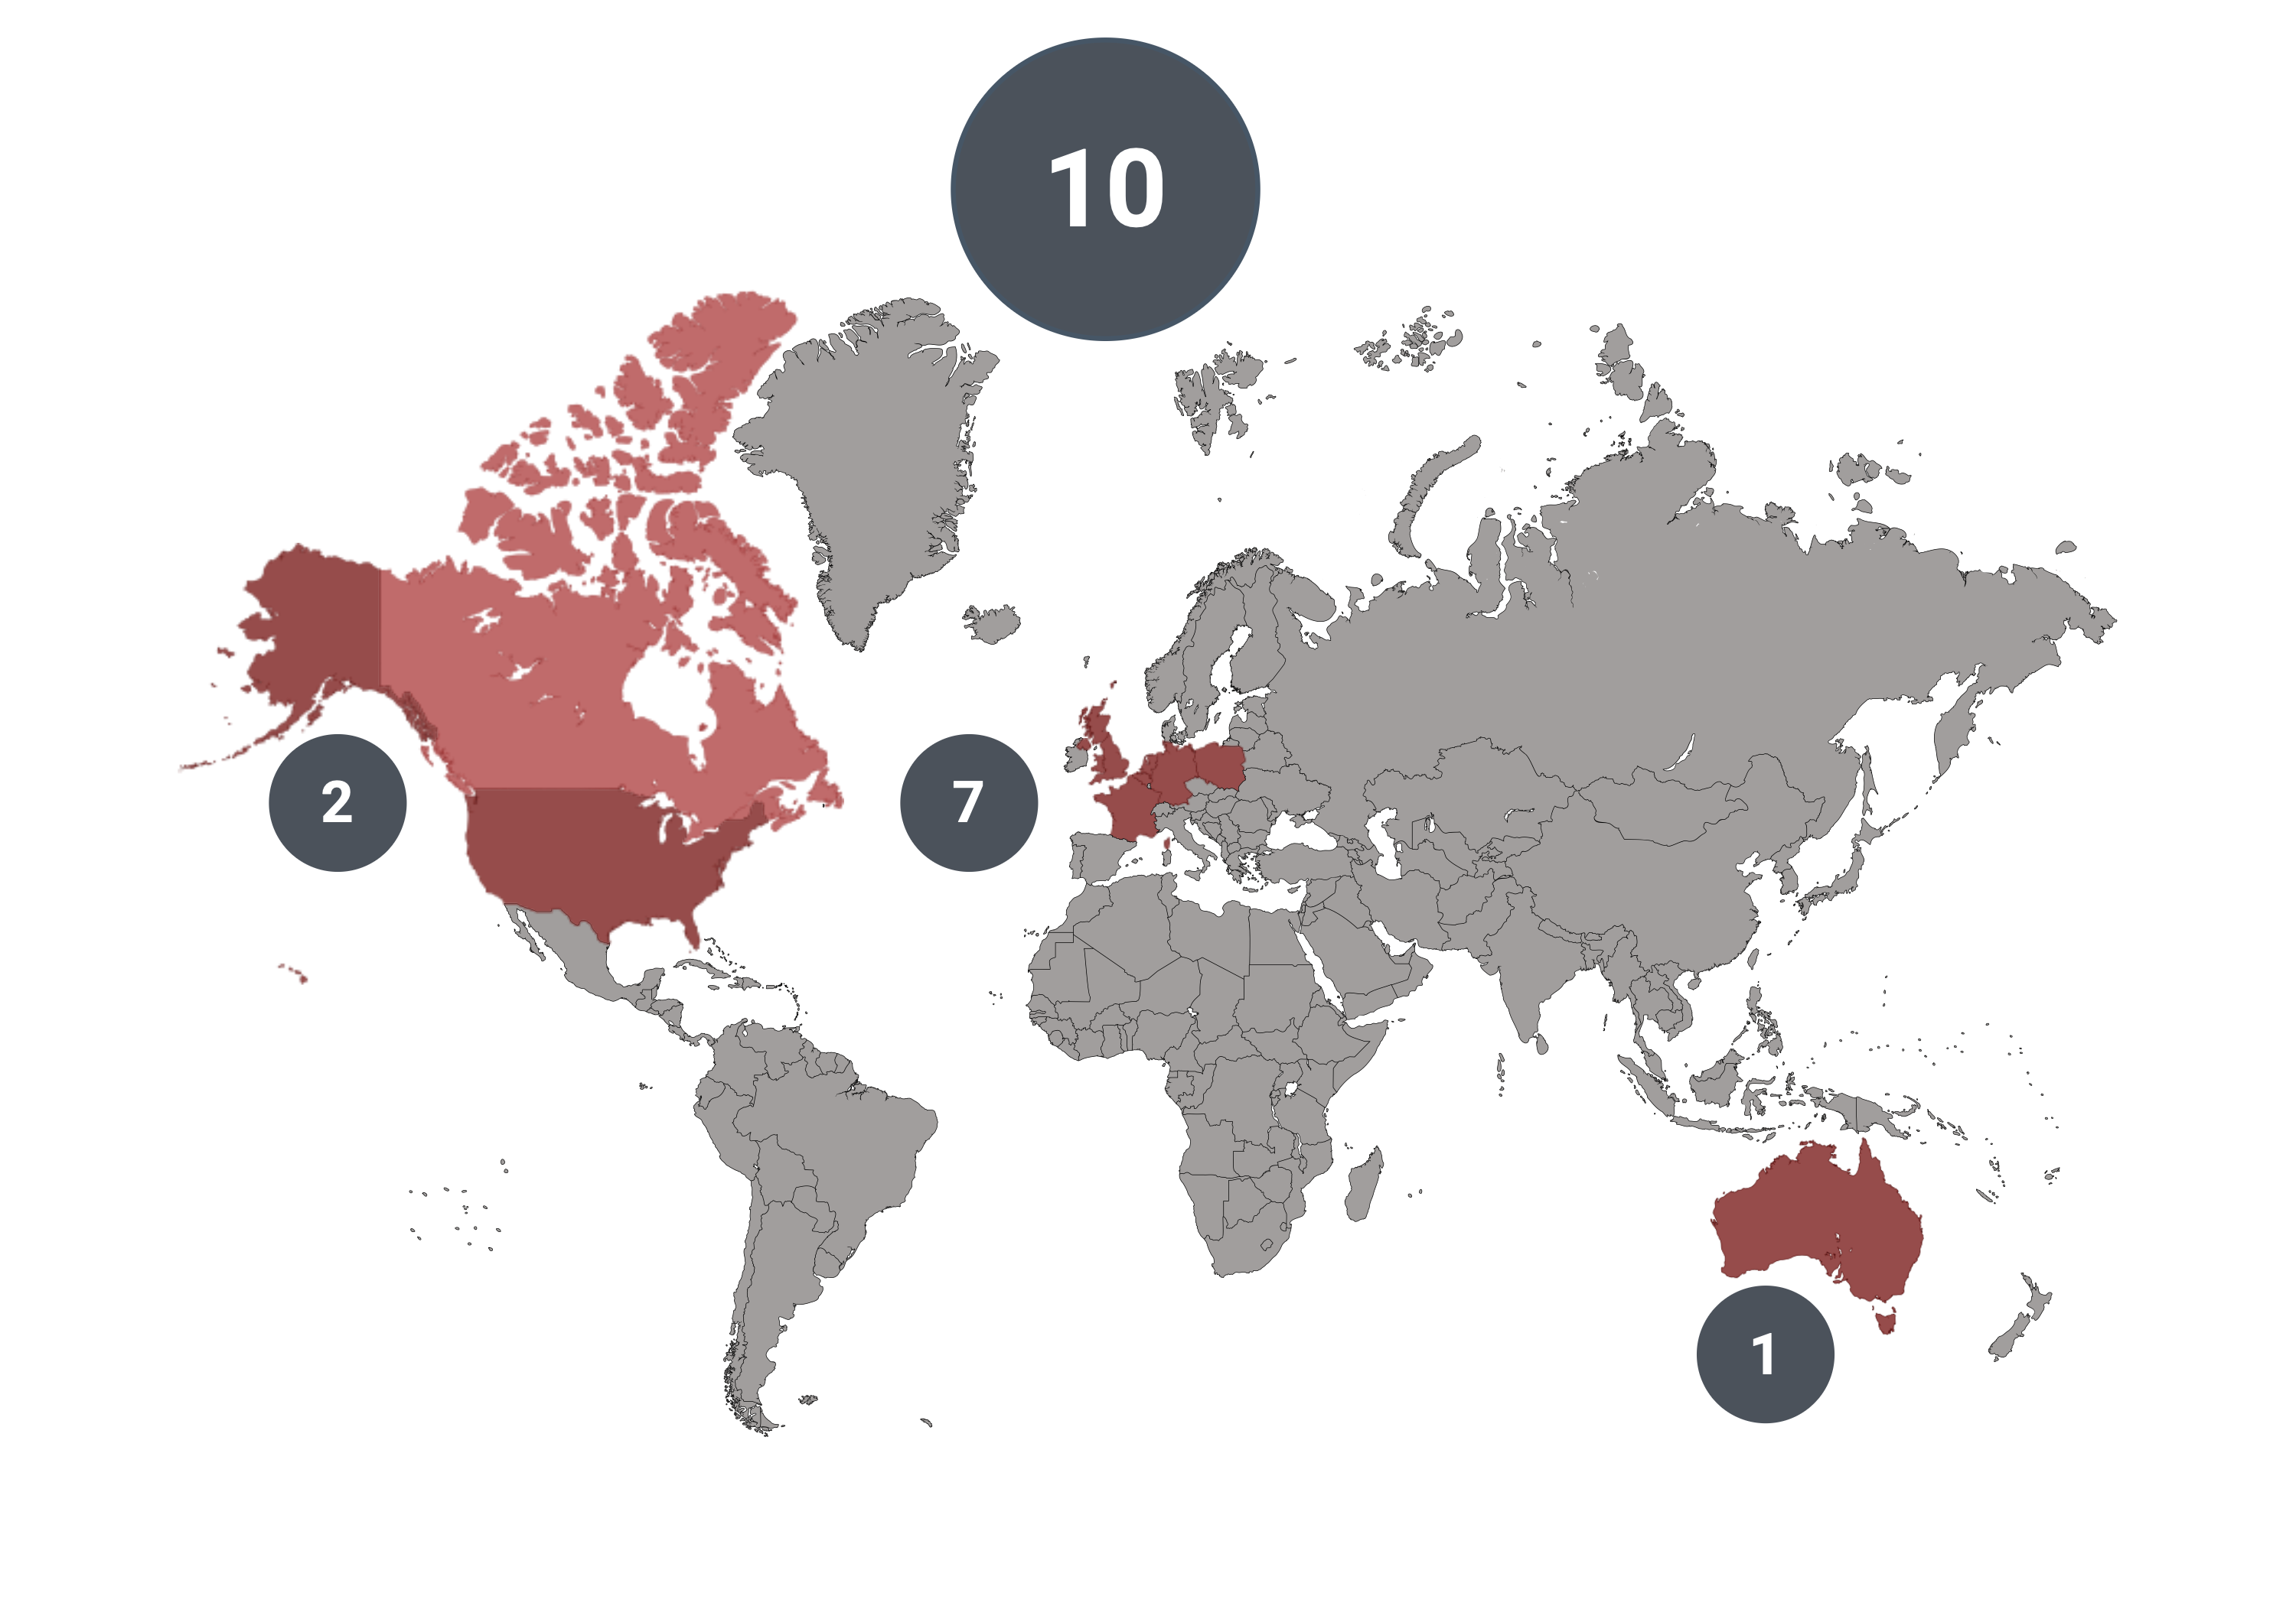
Progress - Centers
Reda Rhellab

Slide 30
Progress - Centers
The Children's Memorial Health Institute,
The Children's Memorial Health Institute,
The Children's Memorial Health Institute,
Reda Rhellab
Confirmed centres
German Heart Centre Munich Munich
Birmingham Children’s hospital Birmingham
Assistance Publique Hôpitaux de Marseille Marseille
Centre Hospitalier Universitair Bordeaux
Children’s National Hospital Washington D.C.
Boston Children’s Hospital Boston
The Royal Children’s Hospital Melbourne
UZ Leuven Leuven
The Children's Memorial Health Institute Warsaw
Erasmus Medical Center Rotterdam
Approached
The Hospital for Sick Children Toronto

Slide 31
Progress – Current status
The Children's Memorial Health Institute,
The Children's Memorial Health Institute,
The Children's Memorial Health Institute,
Reda Rhellab
10-2024
04-2025
Joint Data Registry Agreement → Review at participating centers
Entry of data → 205 patients entered so far
Finalizing ethical/legal documentation
Follow-up completeness

Slide 32
Heart Valve Society
Valve Research Network (VRN) meeting
19th of April 2025
Cairo, Egypt

Slide 33
Introduction
Evaldas Girdauskas

Slide 34
Progress database
Growth database
Donna de Geest
Included patients (n= 2208)

Slide 35
Progress database
Growth database
Donna de Geest
Echo measurements (n= 5590)
Follow-up measurements (n=2848)
5631

Slide 36
Progress database
Participating centers
Donna de Geest
N | Center | Origin
1 | Erasmus University Medical Center | Rotterdam, the Netherlands
2 | Azienda Ospedaliero Universitaria delle Marche | Torrette, Italy
3 | Leipzig Heart Center in Germany | Leipzig, Germany
4 | Azienda Ospedaliera Sant'Andrea Università La Sapienza | Rome, Italy
5 | Augsburg Medical Center | Augsburg, Germany
6 | University Hospital Vienna | Vienna, Austria
7 | Innsbruck University Hospital | Innsbruck, Austria
8 | University Heart Center Hamburg | Hamburg, Germany
9 | Hospital Clínic de Barcelona | Barcelona, Spain
10 | “Vita-Salute” San Raffaele University and Hospital | Milan, Italy
11 | Leiden University Medical Center | Leiden, Netherlands
12 | Salus hospital, in Reggio Emilia | Reggio Emilia, Italy
13 | Pitié Salpetrière | Paris, France
N | Center | Origin
14 | University Hospital Mainz | Mainz, Germany
15 | Oslo University Hospital | Oslo, Norway
16 | Cantonal Hospital | Lugano, Swiss
17 | Institute for Clinical and Experimental Medicine | Prague, Czech Republic
18 | Fondazione Policlinico Universitario Campus Bio-Medico | Rome, Italy
19 | Universitair Medisch Centrum Maastricht | Maastricht, the Netherlands
20 | University Hospital Leuven | Leuven, Belgium
21 | Frankfurt University Hospital | Frankfurt, Germany
22 | Universitätsspital Zürich | Zürich, Swiss
Project 1 | Project 2 | Project 3*
9 | 16 | 3

Slide 37
Scientific Update
Research projects
Donna de Geest
#1 Clinical and Echocardiographic Results of Mitral Valve Repair for Secondary Mitral Valve Regurgitation
Initiators: Anton Tomšič, MD, PhD (PI: Prof. Evaldas Girdauskas, MD, PhD)
#2 The evolution of ventricular arrhythmias after mitral valve surgery in patients with Mitral Valve Prolapse and an Implantable Cardioverter Defibrillator: a multicenter retrospective study with long-term continuous rhythm monitoring
Initiator: Guido Ascione, MD; Michele De Bonis, MD; Nina Ajmone Marsan, MD, PhD; Marta de Riva Silva, MD, PhD; Nikolaos Bonaros, MD
#3 The Effect of Post-repair Mitral Valve Geometry and Function on the Incidence of Recurrent Mitral Regurgitation
Initiator: Meindert Palmen, MD, PhD, Nina Ajmone Marsan, MD, PhD, Anton Tomšič, MD, PhD, Bart JA Mertens (MD, PhD), Robert J.M. Klautz, MD, PhD

Slide 38
Predictors of recurrent mitral regurgitation after initial successful mitral valve repair
Meindert Palmen, Chengji R. Zhao, Nina Ajmone-Marsan,
Anton Tomšič, Bart Mertens, Jesper Hjortnaes and Robert J. M. Klautz

Slide 39
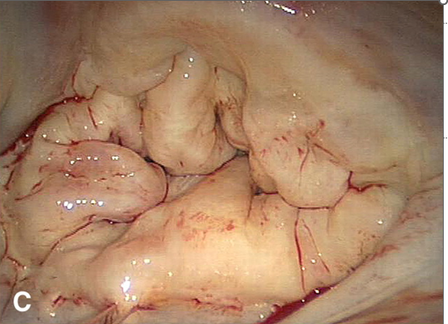
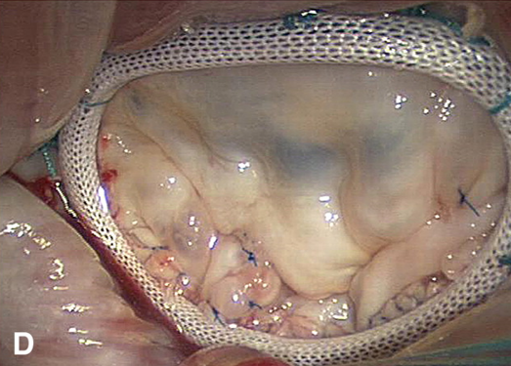
MR recurrence
In centers of excellence mitral valve (MV) repair for primary mitral regurgitation (MR)
>99% repair
< 1% mortality
< 1% recurrence per year
Even after perfect repair, recurrence is present and associated with adverse outcome
Mainly anterior mitral valve leaflet (AMVL) and Barlow disease¹⁻³ up to 20% in a life-time
Only known predictors of recurrent MR
Coaptation length⁴
Residual MR at index operation
Identification of other intraoperative valve characteristics and valve geometry associated with recurrent MR
International retrospective cohort study (HVS Mitral and tricuspid Valvular network)
Collaboration with high volume centers with transthoracic echocardiography (TTE) follow-up
Identification of significant (> MRII+) recurrent MR during follow-up
Intra-operative transoesophageal echocardiography (TOE) → assess intraoperative valve geometry
Matching with similar valve pathologies and complexity and repair techniques without MR
Tomsic et al Interact. Cardiovasc. Thorac. Surg 2018
Tomsic et al Eur. J. Cardiothorac. Surg. 2023
David et al JTCVS 2020
Hage et al Eur. J. Cardiothorac. Surg. 2022

Slide 40
Methods: study overview
Design: Retrospective nested case-control study (NCC)
Population: post-surgical mitral valve repair patients (for primary/degenerative mitral valve disease)
Groups:
Cases: Patients who developed recurrent MR (rMR) during follow-up
Controls: Matched (1:2) patients without rMR at the same follow-up time
Inclusion and matching:
Cases: Identified from participating centers
Controls: Drawn from the LUMC cohort
Matching criteria:
Follow-up duration
Age
Gender
Valve pathology (e.g. P2 prolapse)

Slide 41
Follow-up and endpoints
Start of follow-up: date of intraoperative post-repair TOE
Endpoints:
Cases: Date of rMR
Controls: follow-up ends at time to the corresponding case index date
rMR is defined as significant (≥ grade 2+) rMR during early-, mid-, and long-term postoperative follow-up identified by follow-up TTE/TOE.
Analysis:
Objective: identify which intraoperative post-repair mitral valve geometric measurements are associated with rMR
Statistical approach: univariable and multivariable conditional logistic regression used to analyze continuous intraoperative post-repair mitral valve geometric variables for association with rMR

Slide 42
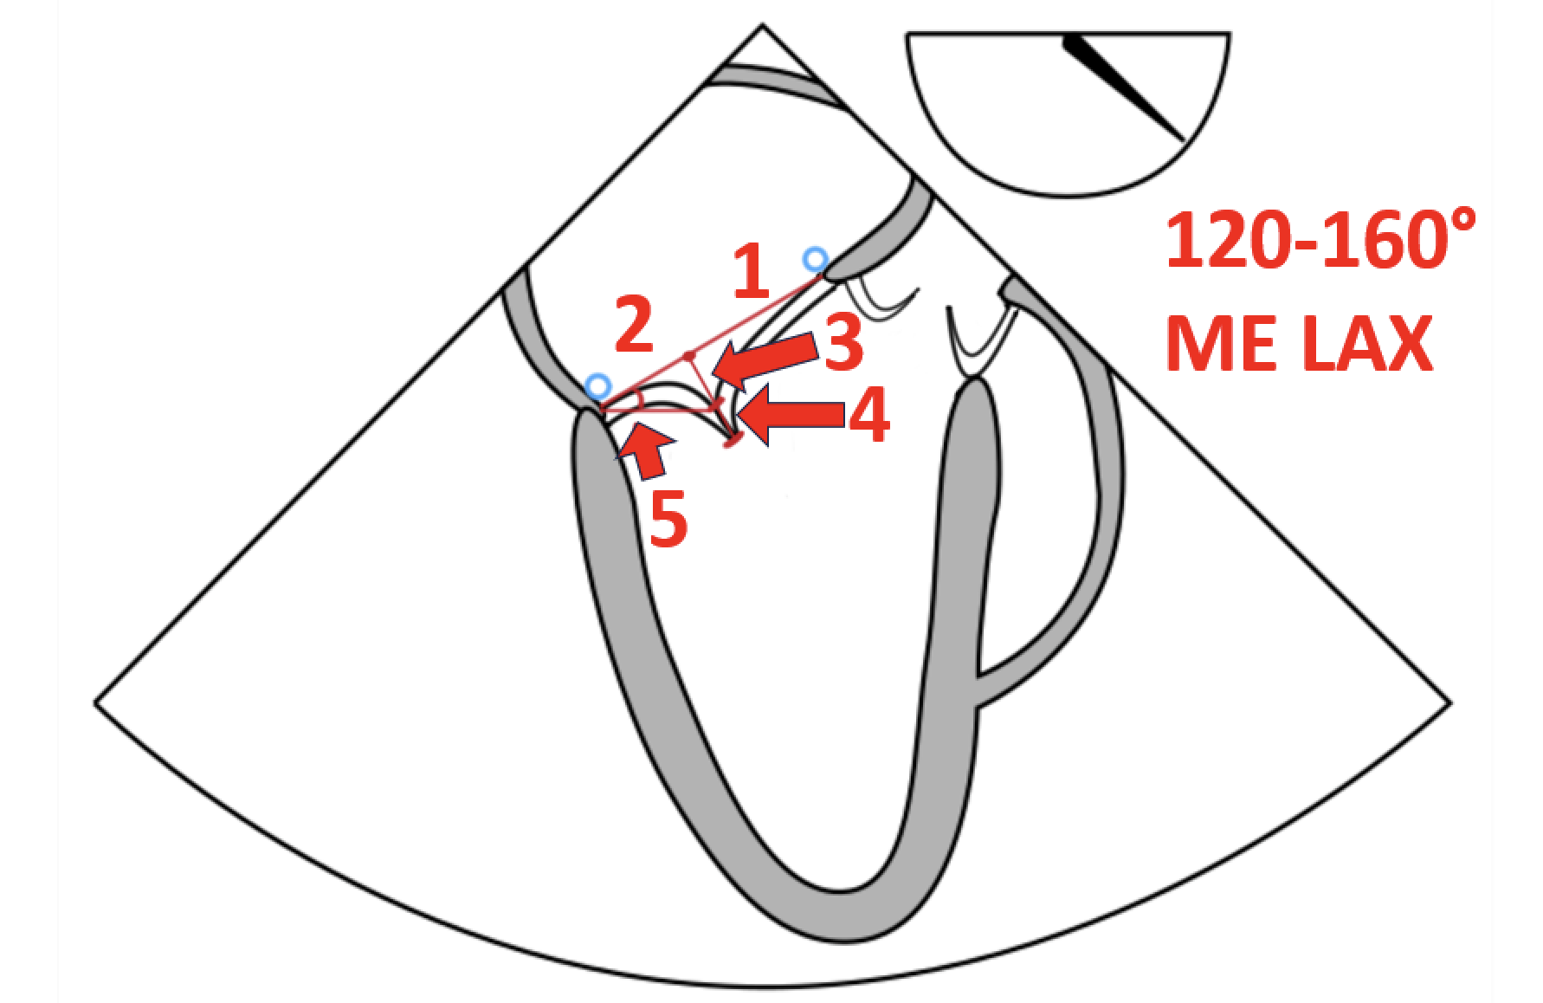
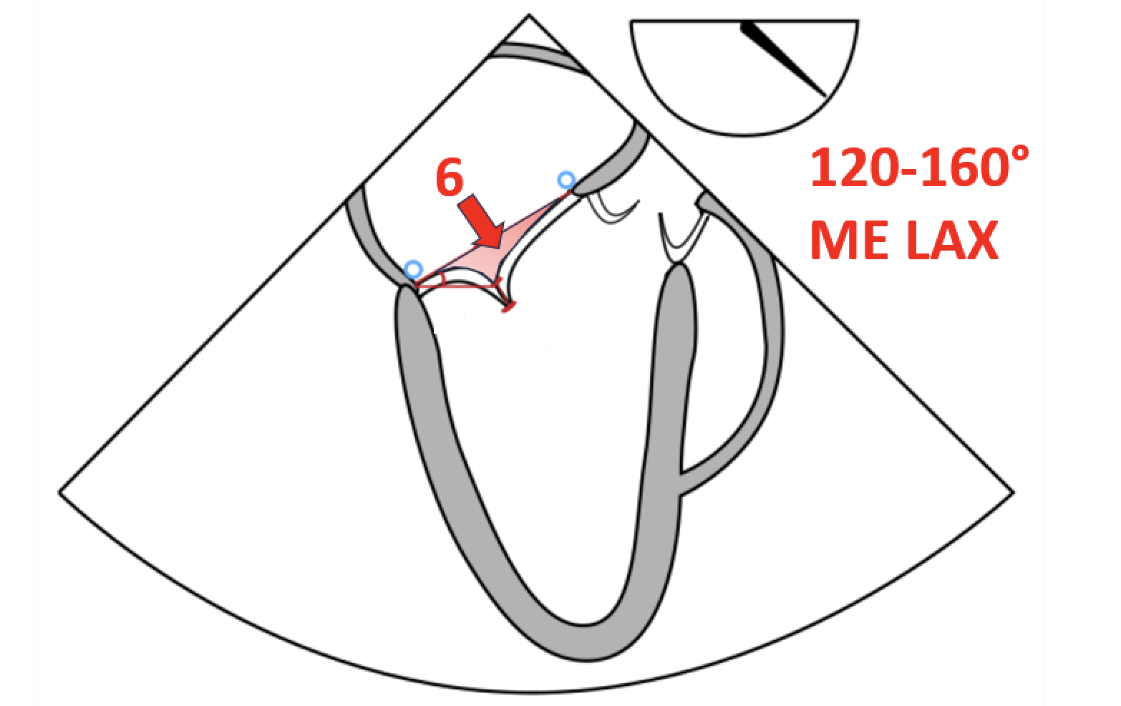
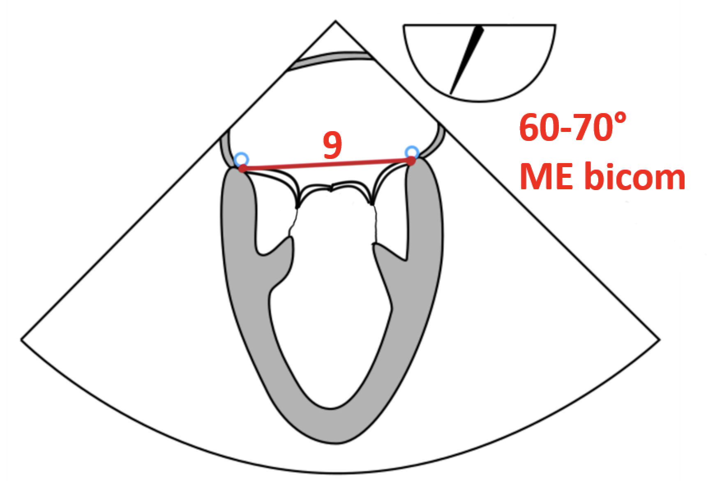
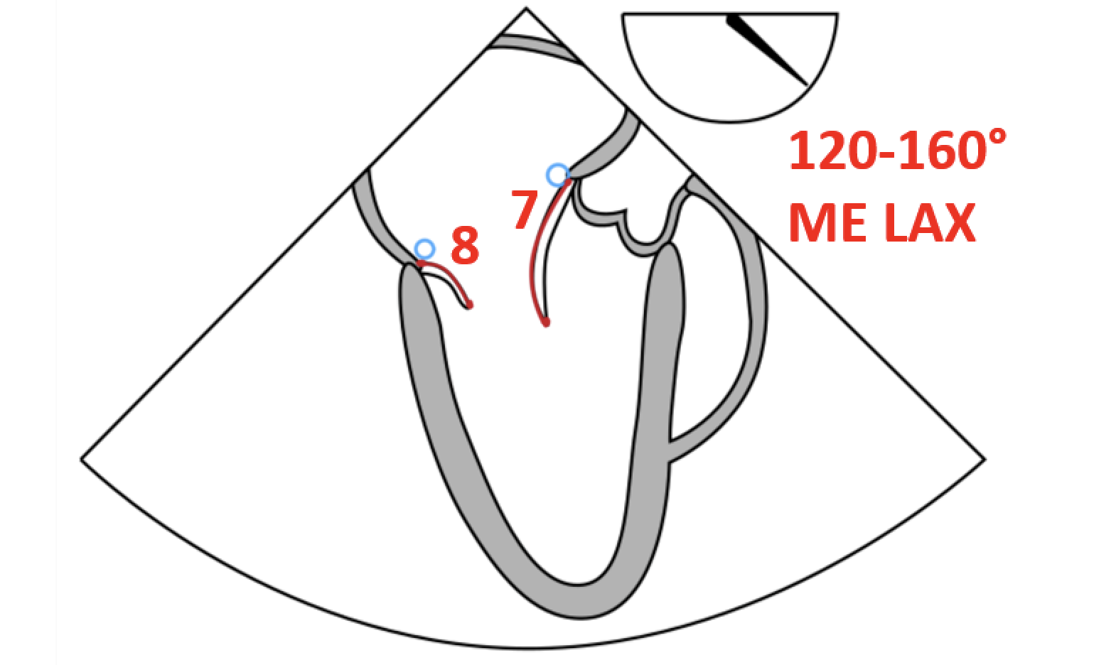
Ratio 1. and 2. describes the position
of coaptation in the annular plane
1: anterior MV leaflet position in the annular plane
2: posterior MV leaflet position in the annular plane
3: coaptation depth
4: coaptation length
5: posterior MV leaflet angle
6: tenting area
7: anterior MV leaflet length (diastole)
8: posterior MV leaflet length (diastole)
9: intercommissural distance (bicommissural)

Slide 43
Scientific update
Project 3
Jesper Hjortnaes
#3 #3 The Effect of Post-repair Mitral Valve Geometry and Function on the Incidence of Recurrent Mitral Regurgitation
Proposal overview: This project aims to identify both qualitative and quantitative intraoperative post-repair TOE parameters associated with future recurrent mitral regurgitation (rMR). A retrospective nested case-control (NCC) study will be conducted, focusing on patients who underwent surgical mitral valve repair for primary (degenerative) mitral valve disease. The study will assess the occurrence of rMR during early, mid-, and long-term postoperative follow-up, as identified through follow-up TTE and/or TOE.
Inclusion period: 2010 until 2024
Initiator: Meindert Palmen, MD, Ph; Nina Ajmone Marsan, MD, PhD; Anton Tomšič, MD, PhD; Bart JA Mertens MD, PhD; Robert J.M. Klautz, MD, PhD
Status: Proposal is approved; centres are recruited.

Slide 44
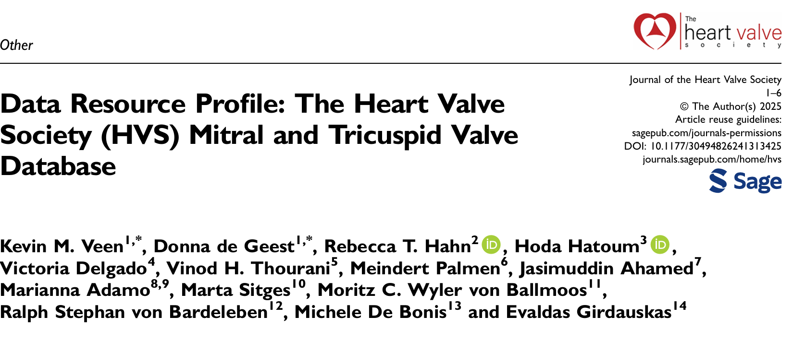
Scientific Update
First paper
Donna de Geest

Slide 45
Financial update
Evaldas Girdauskas Kevin Veen

Slide 46
Thank you for your attention
Carlijn van der Ven, MSc Aorticvalvedatabase@heartvalvesociety.org
Donna de Geest, MSc Mitralvalvedatabase@heartvalvesociety.org
Reda Rhellab , MSc r.rhellab@erasmusmc.org

Slide 47
Scientific update
Project 1
Donna de Geest
#1 Clinical and Echocardiographic Results of Mitral Valve Repair for Secondary Mitral Valve Regurgitation
Proposal overview: This project aims to address the controversies in patient and treatment selection for ventricular functional mitral valve disease by conducting new, multi-center studies to gain insights into the current state of treatment and provide evidence-based recommendations for patient management. The project will provide an overview of the current surgical and transcatheter therapies, compare the clinical and echocardiographic results of these treatments at 1-year post-intervention in real-world settings, assess the potential for left ventricular reverse remodelling with various treatment options, and compare the impact of different surgical repair techniques on diastolic mitral valve performance at 1-year post-surgery.
Inclusion period: 01-10-2024 until 30-09-2025 (with follow-up until 2026).
Initiator: Anton Tomšič, MD, PhD (PI: Prof. Evaldas Girdauskas, MD, PhD) from Augsburg University hospital.
Status: Proposal is approved; centres are recruited.

Slide 48
Scientific update
Project 2
Donna de Geest
#2 The evolution of ventricular arrhythmias after mitral valve surgery in patients with Mitral Valve Prolapse and an Implantable Cardioverter Defibrillator: a multicenter retrospective study with long-term continuous rhythm monitoring
Proposal overview:This project aims to assess the evolution of ventricular arrhythmias in patients with mitral valve prolapse and an Implantable Cardioverter Defibrillator (ICD) undergoing surgery for significant mitral regurgitation. The project will provide an overview of arrhythmic outcomes, evaluating the incidence, type, and predictors of recurrent post-surgical sustained ventricular arrhythmias in these subjects. The need of ICD therapies, transcatheter ablation of ventricular arrhythmias and escalation of antiarrhythmic therapy at follow-up will be also evaluated. Arrhythmias will be centrally assessed by a Clinical Events Committee, in order to ensure consistency in events reporting.
Inclusion period: 1999 until 2024 (with follow-up until 2025).
Initiator: Guido Ascione, MD; Michele De Bonis, MD; Nina Ajmone Marsan,
MD, PhD; Marta de Riva Silva, MD, PhD; Nikolaos Bonaros, MD
Status: Proposal is approved; centres are recruited.

Slide 49
Progress database
Participating centers
Donna de Geest
N | Center | Origin | Project 1 | Project 2 | Project 3*
1 | Erasmus University Medical Center | Rotterdam, the Netherlands | x | x
2 | Azienda Ospedaliero Universitaria delle Marche | Torrette, Italy | x | x
3 | Leipzig Heart Center in Germany | Leipzig, Germany |  | x
4 | Azienda Ospedaliera Sant'Andrea Università La Sapienza | Rome, Italy
5 | Augsburg Medical Center | Augsburg, Germany | x | x
6 | University Hospital Vienna | Vienna, Austria | x | x
7 | Innsbruck University Hospital | Innsbruck, Austria | x | x
8 | University Heart Center Hamburg | Hamburg, Germany | x | x
9 | Hospital Clínic de Barcelona | Barcelona, Spain | x | x
10 | “Vita-Salute” San Raffaele University and Hospital | Milan, Italy |  | x
11 | Leiden University Medical Center | Leiden, Netherlands | x | x
12 | Salus hospital, in Reggio Emilia | Reggio Emilia, Italy
13 | Pitié Salpetrière | Paris, France |  | x
14 | University Hospital Mainz | Mainz, Germany |  | x
15 | Oslo University Hospital | Oslo, Norway |  | x
16 | Cantonal Hospital | Lugano, Swiss |  | x
17 | Institute for Clinical and Experimental Medicine | Prague, Czech Republic |  | x
18 | Fondazione Policlinico Universitario Campus Bio-Medico | Rome, Italy | x
19 | Universitair Medisch Centrum Maastricht | Maastricht, the Netherlands |  | x
20 | University Hospital Leuven | Leuven, Belgium |  |  | x
21 | Frankfurt University Hospital | Frankfurt, Germany |  |  | x
22 | Universitätsspital Zürich | Zürich, Swiss |  |  | x

Slide 50
Database
Donna de Geest

