Slide 1
HVS Annual Meeting 2023, 6 October
Valve Research Network meeting
Aortic and Mitral-Tricuspid Valve Database

Slide 2
Content
Introduction Kluin
Aortic Valve Research Network
Database update van der Ven
Medical arm Youssefi
Financial Plan
Scientific update Verbrugghe

Slide 3
Introduction

Slide 4
Database update

Slide 5
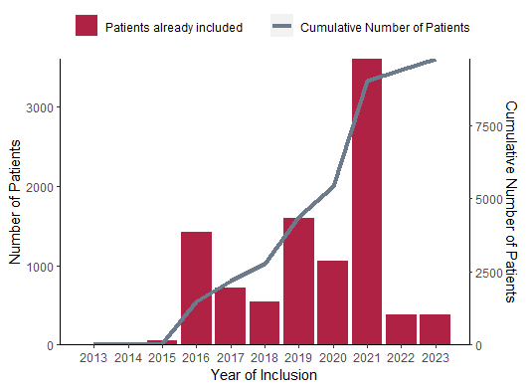
Annual growth of database
N=10,369
In 2019 39 active centres → in 2023 49!

Slide 6
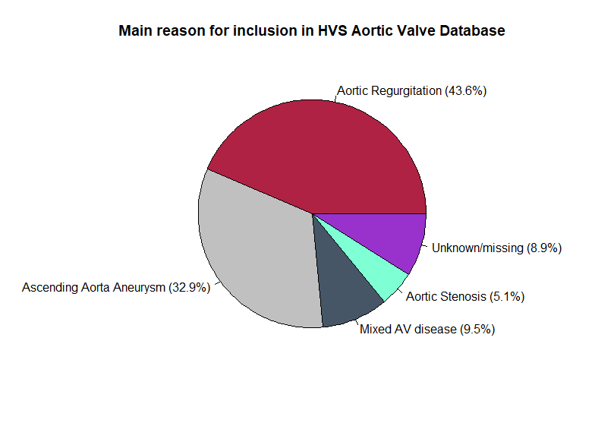
Main reason for referral + median follow-up
Median follow-up: 2.99 years (IQR: 0.44 – 6.66)

Slide 7
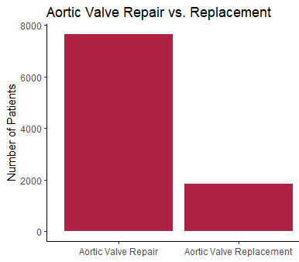
Aortic Valve Repair vs. Replacement
80.6%
19.4%

Slide 8
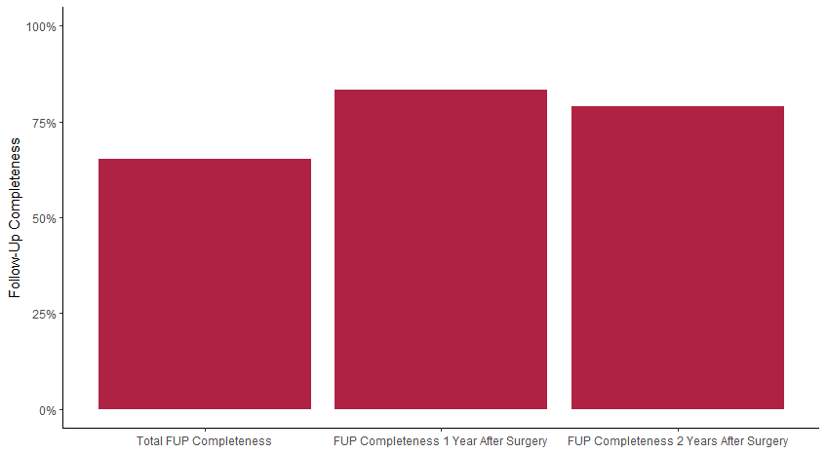
Follow-Up Completeness
65.2%
83.4%
75.3%

Slide 9
Medical Arm

Slide 10
Financial Plan

Slide 11
Scientific Update

Slide 12
Published projects
2019:
de Heer F, Kluin J, et al. AVIATOR: An open international registry to evaluate medical and surgical outcomes of aortic valve insufficiency and ascending aorta aneurysm. J Thorac Cardiovasc Surg. 2019;157(6):2202–2211.e7.
Lansac E, Youssefi P, et al. Aortic Valve Surgery in Nonelderly Patients: Insights Gained From AVIATOR. Semin Thorac Cardiovasc Surg. 2019;31(4):643–649.
2022:
Chauvette V, El-Hamamsy, I. Outcomes of valve-sparing surgery in heritable aortic disorders: results from the AVIATOR Registry. Eur J Cardiothorac Surg 2022; ezac366.
Gofus J, Vojáċek, J. Comparison of bicuspidization and Ross procedure in the treatment of unicuspid aortic valve disease in adults – Insight from the AVIATOR registry. Front. Cardiovasc. Med. (2022) 9:900426. doi: 10.3389/fcvm.2022.900426
2023:
Arabkhani B, Klautz RJM, de Heer F, De Kerchove L, El Khoury G, Lansac E et al. A multicentre, propensity score matched analysis comparing a valve-sparing approach to valve replacement in aortic root aneurysm: Insight from the AVIATOR database. Eur J Cardiothorac Surg 2023; doi:10.1093/ejcts/ezac514.
Van Hoof L, Lamberigts M, Noé D, et al. Matched comparison between external aortic root support and valve-sparing root replacement. Heart January 17, 2023. doi:10.1136/ heartjnl-2022-321840
El Mathari S, Boulidam N, de Heer F, de Kerchove L, Schäfers HJ, Lansac E, Twisk JWR, Kluin J; Aortic Valve Research Network Investigators. Surgical outcomes of aortic valve repair for specific aortic valve cusp characteristics; retraction, calcification, and fenestration. J Thorac Cardiovasc Surg. 2023 May 26:S0022-5223(23)00444-0. doi: 10.1016/j.jtcvs.2023.05.020. Epub ahead of print. PMID: 37244390.

Slide 13
Ongoing Research Projects
Pouya Youssefi Emmanuel Lansac | Title: | Aortic valve repair using external aortic ring annuloplasty: a multicentric analysis of outcomes
 | Data extraction: | November 2018
 | Current status: | Ready for submission
Frederiek de Heer Jolanda Kluin | Title: | Using artificial intelligence to predict the best surgical strategy in patients with aortic valve regurgitation of aortic aneurysm. Insights from the Heart Valve Society Aortic Valve Database
 | Data extraction: | July 2020
 | Current status: | Presented at HVS

Slide 14
Ongoing Research Projects
Matteo Pettinari Peter Verbrugghe Laurent de Kerchove | Title: | Impact of preoperative aortic regurgitation and leaflet repair on immediate and long term outcomes of valve sparing root replacement in patient with TAV.
 | Data extraction: | April 2020
 | Current status: | Writing manuscript
Erwan Salaun Philippe Pibarot Ismail El-Hamamsy | Title: | One-year clinical and hemodynamic outcomes in patients treated for aortic insufficiency and ascending aorta aneurysm. The one-year flight of AVIATOR.
 | Data extraction: | April 2020
 | Current status: | Waiting response of participating centers

Slide 15
Ongoing Research Projects
Mariya Saddiqa Marianna Buonocore Peter Verbrugghe | Title: | Aortic valve repair and replacement in patients affected by infective endocarditis: short and mid-term results from the AVIATOR Registry.
 | Data extraction: | July 2021
 | Current status: | Analyzing data
Anahita Noruzi Hanneke Takkenberg | Title: | Aortic Valve repair in adults: determinants of surgical techniques and clinical outcome from the AVIATOR registry.
 | Data extraction: | March 2021
 | Current status: | Analyzing data

Slide 16
Ongoing Research Projects
Shanti Khargi Hanneke Takkenberg Pepijn Grashuis | Title: | Type of cusp fusion and commissural orientation as a predicting factor of aortic valve repair failure in patients with bicuspid aortic valves
 | Data extraction: | December 2020
 | Current status: | Data analysis ready, finalizing manuscript
Vincent Hanet Bernhard Gerber | Title: | Evaluation of gender influence on left ventricular dimensions and outcome in aortic regurgitation.
 | Data extraction: | March 2021
 | Current status: | Finalizing manuscript

Slide 17
Ongoing Research Projects
Carlotta Brega | Title: | Aortic Valve Sparing Root Replacement And Myocardial Dysfunction
 | Data extraction: | December 2022
 | Current status: | Review of manuscript by Scientific Committee
Danial Pichoy | Title: | Propensity-Matched Comparison of Aortic Valvuloplasty and Prosthetic Aortic Valve Replacement in Adults (CAVIAAR extension)
 | Data extraction: | Not yet
 | Current status: | Data analysis

Slide 18
HVS Annual Meeting 2023, 6 October
Valve Research Network meeting
Aortic and Mitral Tricuspid Valve Database

Slide 19
Content
Mitral Tricuspid Valve Research Network
Introduction Girdauskas
Database update de Geest Development choices Progress development Planning Financial plan Girdauskas

Slide 20
Introduction

Slide 21
Development choices

Slide 22
Features CRF
Procedural information
Procedural information
Echo
Echo
MRI
Additional clamp session
Additional clamp session
Follow-up
Follow-up
Reintervention
Reintervention
Patient reported outcomes

Slide 23
Center recruitment
Consecutive inclusion
Project based inclusion
HVS Mitral Tricuspid Valve Database
Notes:
In the aortic dataase,

Slide 24
Center recruitment
Center recruitment and research in the HVS aortic database
HVS Aortic Valve Database
Research Proposal
Aortic regurgitation
Aortic stenosis

Slide 25
Center recruitment
Consecutive inclusion and research in the HVS Mitral Tricuspid Valve database
HVS Mitral Tricuspid Valve Database
Research Proposal
Mitral regurgitation Mitral stenosis
Tricuspid regurgitation
Tricuspid stenosis
Notes:
In the aortic datase

Slide 26
Center recruitment
Project based inclusion center recruitment in the HVS Mitral Tricuspid Valve database
HVS Mitral Tricuspid Valve Database
Project Proposal
Mitral regurgitation Mitral stenosis
Tricuspid regurgitation
Tricuspid stenosis
Notes:
In the aortic dataase,

Slide 27
Center recruitment
Center recruitment in the HVS Mitral Tricuspid Valve database
HVS Mitral Tricuspid Valve Database
Project Proposal
Research Proposal

Slide 28
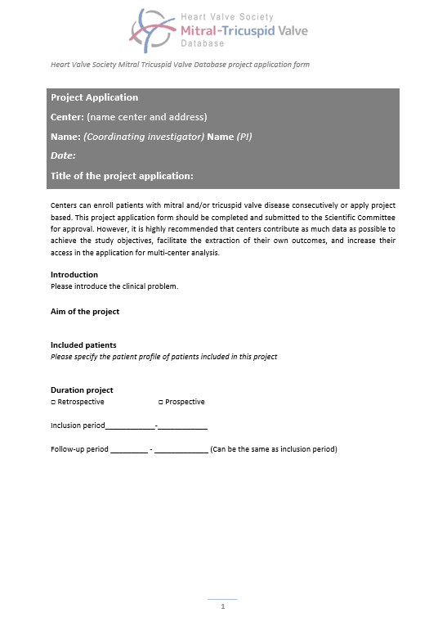
Projects
Discussion: Ideas for possible project proposals
Download the Project Application Form on the website

Slide 29
Progress development

Slide 30
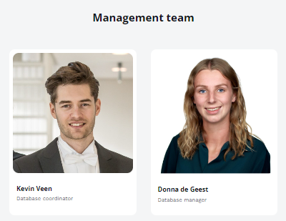
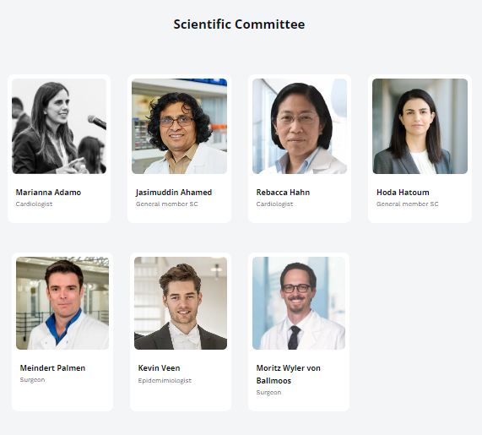
Progress

Slide 31
Progress
Complete the team
Core leaders
Scientific committee
Management Team
Documentation
Protocol
Case Report Form (CRF)
Data Dictionary
Participation Agreement
Data Transfer Agreement
Research proposal Form
Template informed consent
Project Application Form
Marketing material
Logo
Website
Information letter preliminary recruitment

Slide 32
Planning

Slide 33
Planning
Oct​ | Nov​ | Dec​ | Jan ​ | Feb​ | Mar​ | Apr​ | May​ | Jun​ | Jul​ | Aug​ | Sep​
Creating eCRF
Data collection
Database maintenance

Slide 34
Financial plan

